Slide 1



Enhancing classification of autism spectrum disorder using resting-state fMRI with machine learning approach and dimensionality reduction
By: Parisa Daj , Mehrnaz Hosseinzadeh , Anis Zahedifard ,Yousef Ghanbari

Slide 2

What is Autism Spectrum Disorder (ASD)?
What
is Autism Spectrum Disorder (ASD)?
Why
Investigating ASD is crucial?
Earlier Detection
Lead into Specialized Education

Slide 3
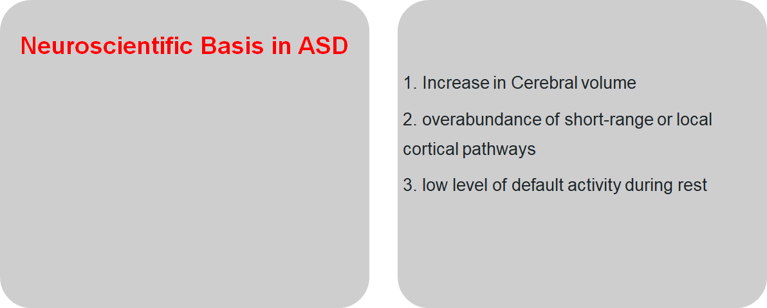
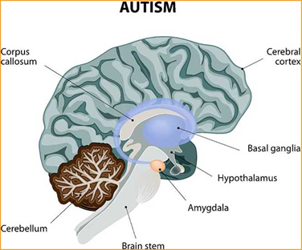
Introduction

Slide 4
Scientific Question
How
well can we detect ASD condition based on resting-state fMRI data

Slide 5

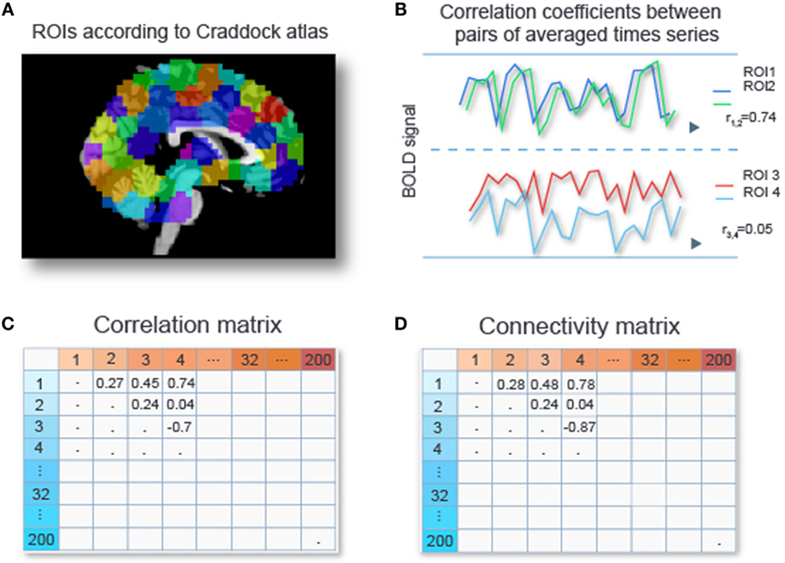
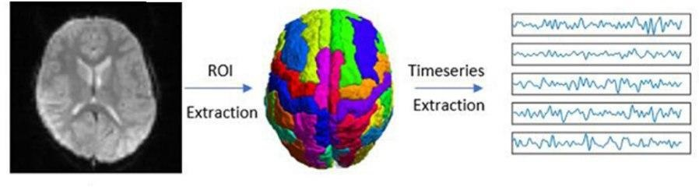
Autism Brain Imaging Data Exchange (ABIDE)
Kassraian-Fard P, Matthis C, Balsters JH, Maathuis MH, Wenderoth N. Promises, pitfalls, and basic guidelines for applying machine learning classifiers to psychiatric imaging data, with autism as an example. Frontiers in psychiatry. 2016 Dec 1;7:177.

Slide 6
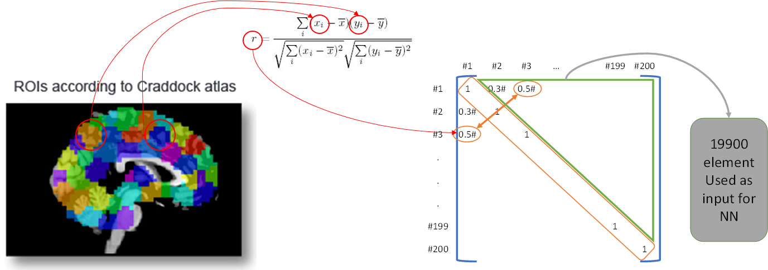
ماتریس کورولیشن

Slide 7
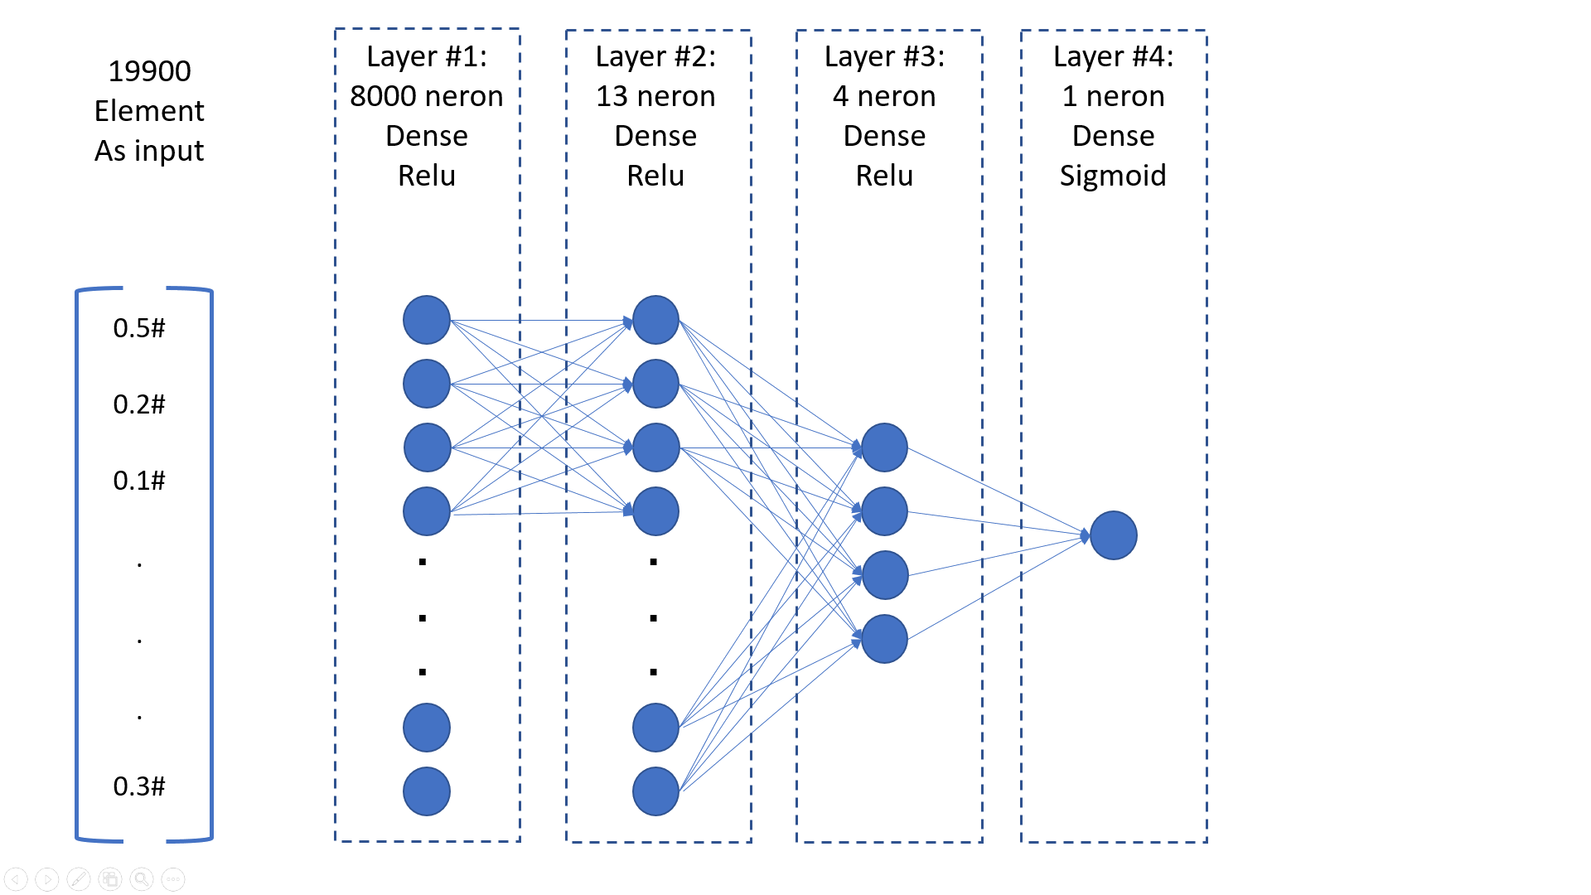
نتایج اولیه
Accuracy | Algorithm | Reference
69% | Linear SVM | Plitt et aI., 2015
66% | Gaussian SVM | Chen et aI., 2015
67% | SVC | Abraham et aI.,2017
70% | Deep Neural Net | Heinsfeld et aI.,2018
90.8% | Random Forest | Chen et aI., 2015
70.3% | ASD Diag Net | Eslami T. et al. 2019
72% | MLP | Our Project, 2020
F1 Score: 0.76

Slide 8
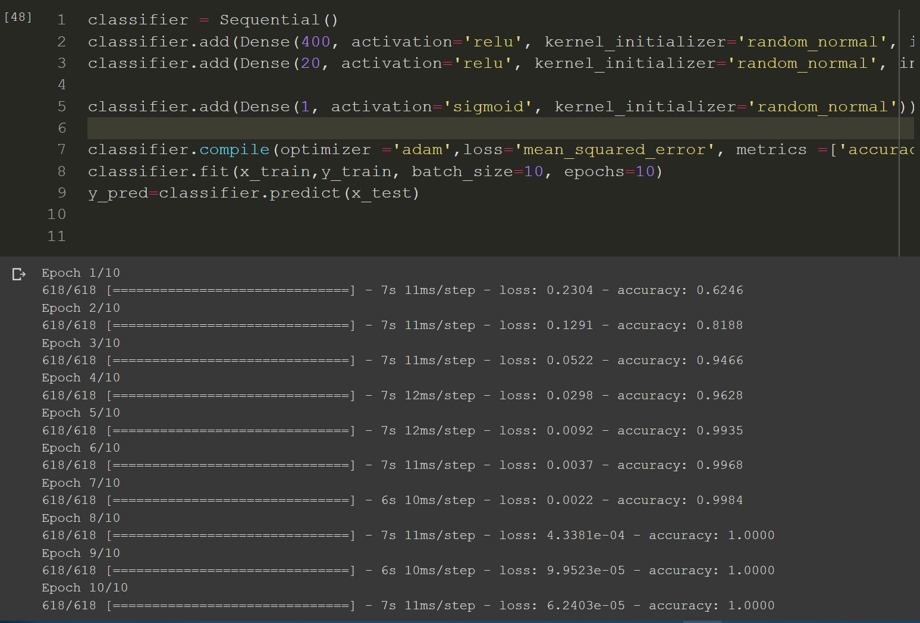
اورفیت شدن و نتایج با شبکه ساده
1 layer (200 rois)
1 neuron 1 sigmoid layer
75% accuracy
0.66 F1
2 layers:(200 rois)
4 neuron in hidden Relu layer
1 neuron in sigmoid layer
76% accuracy
0.63 F1

Slide 9
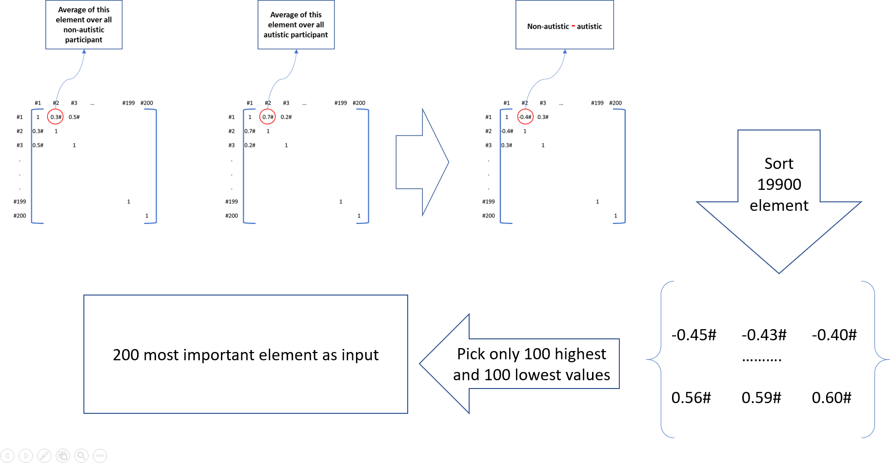
کم کردن دیتای ورودی

Slide 10
نتایج نهایی کلی
2 layers:(200 rois)
4 neuron in hidden Relu layer
1 neuron in sigmoid layer
80% accuracy
0.71 F1

Slide 11
نتایج نهایی تفکیکی سن جنس

Slide 12
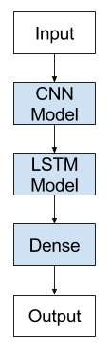
کارهای پیشنهادی
پیشنهاد: شبکه‌های حافظه دار برای سری زمانی مثل CNN+LSTM، BiLSTM, ..
Besides, in the future, we can improve our classifier using ANFIS. We can also predict the severity of the autism spectrum disorder.
محدودیت: حجم کم داده‌ها

Slide 13





